Slide 1
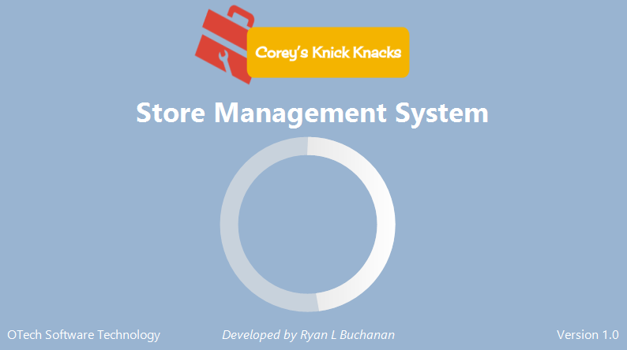
Corey's Knick Knacks
Inventory Management System
Version 1.0
Ryan L. Buchanan

Slide 2
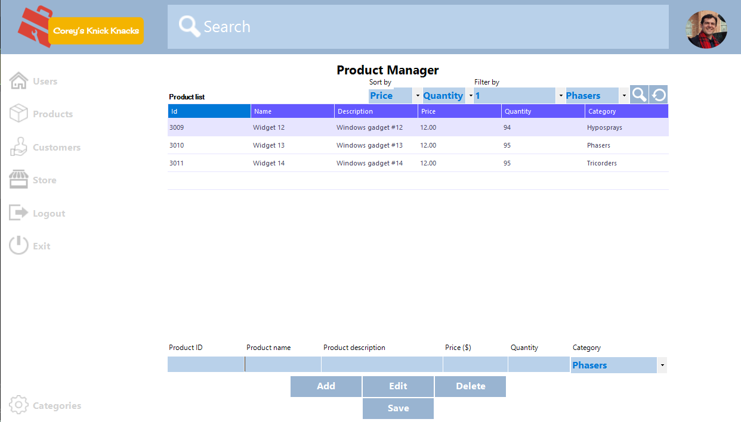
CKK Inventory Management System
Desktop Application

Slide 3
CKK Inventory Management System
Desktop Application
How-to Guide
o Step 1 - Start up and login
o Step 2 – Add, edit and remove products
o Step 3 – Online store purchase of products

Slide 4
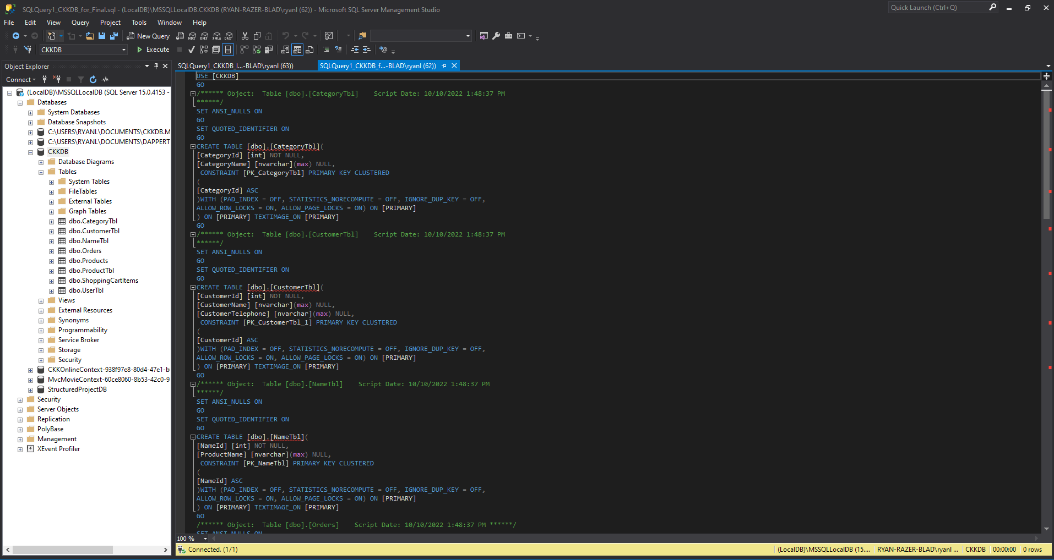
CKK Server Application
Microsoft SQL Server Management Studio

Slide 5
CKK Server Application
Microsoft SQL Server Management Studio
How-to Guide
o Database and Table Creation
o INSERT INTO Script (in lieu of GUI)

Slide 6
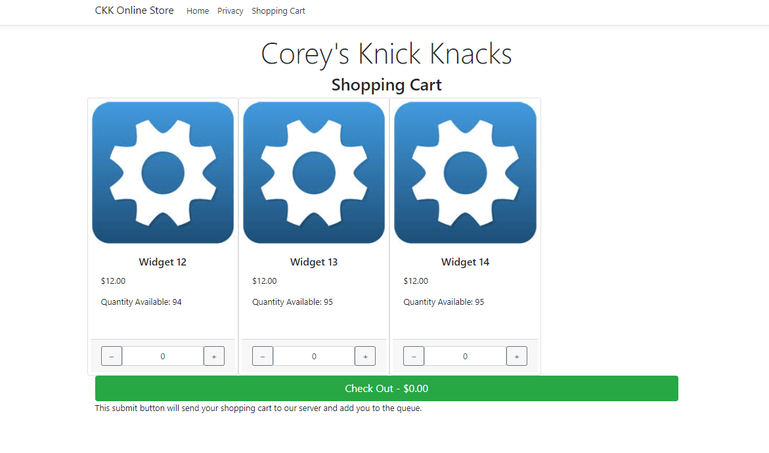
Client Web Application
ASP.Net

Slide 7
Client Web Application
ASP.Net
How-to Guide
o Step 1 - Choose purchase items
o Step 2 - Check out

